Slide 1
Fixed Penetration Trends in Colombia
Prueba Técnica Cable & Wireless - Francisco J. Suárez Franco

Slide 2
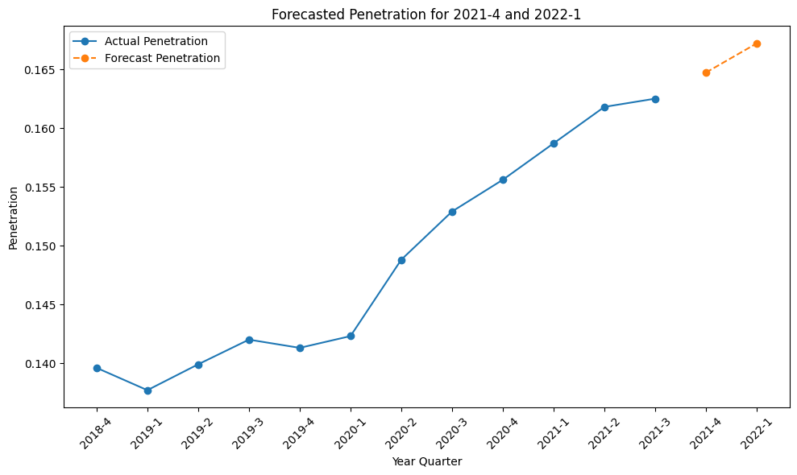
Positive Growth in Fixed Internet Penetration: Colombia's Upward Trend
Forecasting Fixed Internet Penetration: Sustained Growth into 2022.
The evolution of penetration is positive since Q1 2020, a clear upward trend is observed. Current penetration is high compared Colombia´s growth rate.
By making a forecast (Linear Regression) for the next two quarters, we can see that penetration continues its positive trend, reaching 16.47% and 16.72% for Q4 2021 and Q1 2022, respectively.
Notes:
1. How is the evolution of the general penetration of fixed internet in Colombia? Are there specific trends that can be identified from the graph? Is the current penetration high or low? What is the maximum penetration that can be reached if it is measured as instructed in this question?

Slide 3
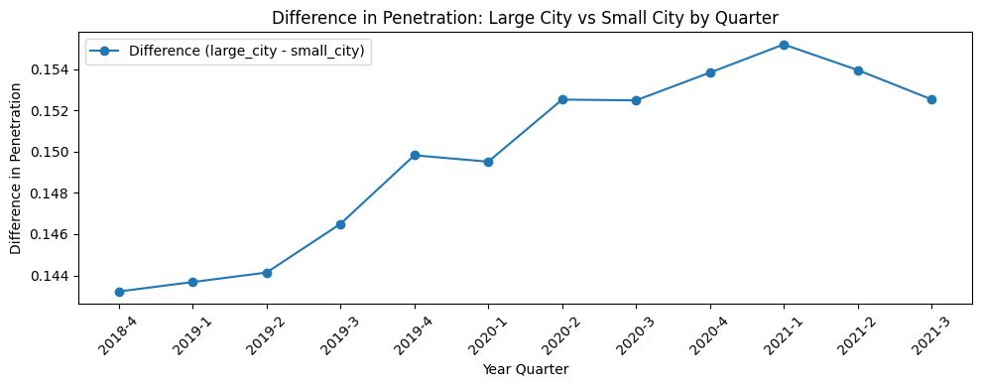
Large vs Small Cities Penetration: A Growing Gap Since 2018
The evolution of penetration differs significantly between large cities and smaller towns. As we can see in the graph, the gap has been growing from Q4 2018 to Q1 2021, decreasing slightly in Q2 and Q3 2021. However, the overall trend shows positive growth in the existing gap in favour of Large City.
Notes:
2. Does the evolution of the penetration differ for big and small cities? Is the gap increasing or decreasing

Slide 4
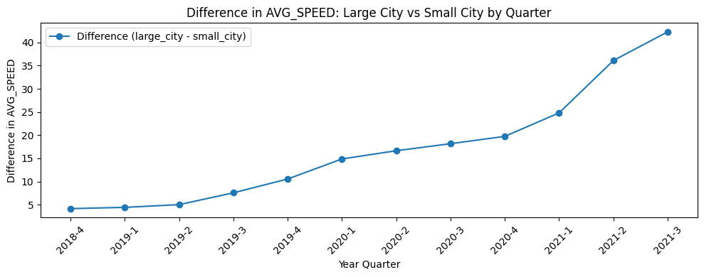
Average Internet Speeds: Growing Gap Between Large and Small Cities.
The difference becomes more pronounced as the quarters progress. While penetration and connections increase, so does the need for higher connection speeds. However, it is notable that speeds grow more significantly in large cities. This may be due to bandwidth saturation as the number of connections rises over time.
Notes:
3. How does average internet offered speeds vary between big cities and small cities? Is the gap increasing or decreasing

Slide 5
ISP Market Share: High Concentration in Big Cities, Fragmentation in Small Cities.
Large Cities:
Small Cities:
Dominance of a Few Key Providers:
"COMUNICACIÓN CELULAR S.A. COMCEL S.A." leads with 42.57%.
Other major players include "UNE EPM TELECOMUNICACIONES S.A." (22.21%) and "COLOMBIA TELECOMUNICACIONES S.A. E.S.P." (15.13%).
"Others" accounts for only 5.55%, indicating a highly concentrated market.
Greater Provider Diversity:
"COMUNICACIÓN CELULAR S.A. COMCEL S.A." has a smaller share (19.43%), while "Others" leads with 34.34%.
Smaller providers like "EDATEL S.A." (9.67%) and "RURALINK S.A.S." (2.17%) hold greater significance, reflecting a more fragmented market.
The potential implications of this difference could be the service providers' strategy to focus on penetrating large cities, where higher revenue and greater ROI can be expected from investments in infrastructure or antennas to improve the user experience.
Notes:
4. Is the distribution between internet service providers different in big cities and small cities?
What are the possible implications of that difference?

Slide 6
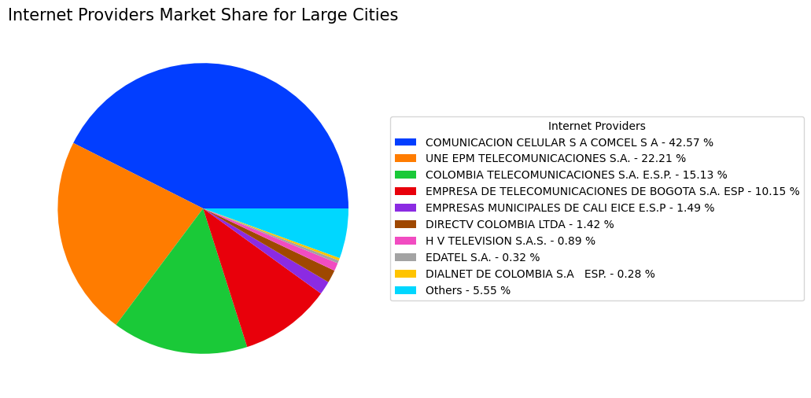
Optimizing Data Visualization: Moving Beyond Pie Charts for Clarity and Precision
Pros:
Clear Proportions: Easy to understand market dominance (e.g., COMCEL).
Visually Appealing: Colors and design draw attention effectively.
Quick Comparison: Useful for contrasting big and small cities.
Cons:
Too Much Detail: Hard to distinguish smaller categories (e.g., "Others").
Space Usage: Extensive legends overcrowd the chart.
Imprecise Comparisons: Similar-sized categories are not easy to differentiate.
Overloaded Data: Too many actors reduce clarity.
Recommendation:
Use bar charts or treemaps for greater precision and less visual clutter.
Notes:
4. Is the distribution between internet service providers different in big cities and small cities?
What are the possible implications of that difference?

Slide 7
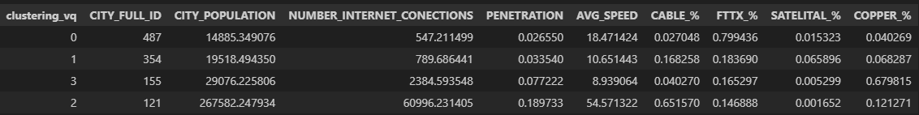
City Clustering: Key Characteristics Across 4 Identified Groups
Group 2: Leading Cities with High Population, Maximum Speeds, and Cable Dominance.
0
FTTX as predominant technology
Largest number of cities.
Lowest penetration.
Second-lowest speed.
1
Second-largest cluster of cities
representing intermediate regions.
Second-lowest number of cities
Average in every evaluation variable.
2
CABLE as predominant technology
Cities with the largest populations
Highest speeds
Highest penetration
3
High dependence on COPPER
Low penetration.
Lowest average speeds.
Notes:
5. Can cities be grouped or clustered based on other indicators in the dataset? What are the characteristics from each cluster?

Slide 8
Strategy: Differentiated Approach
Customized Market Approach: Large and Small City Focus.
Large Cities:
Small Cities:
Objective: Compete with major players (COMCEL, UNE EPM) by offering high-speed, reliable internet through fiber optic technology.
Differentiators: Premium services, innovation, and sustainability.
Key Cities: Cluster 2 (Bogotá, Medellín, Cali, Barranquilla, Bucaramanga).
Objective: Serve underserved areas with affordable, reliable plans using hybrid infrastructure.
Differentiators: Affordability, community focus, and local partnerships.
Key Cities: Cluster 2 (Villavicencio, Manizales, Armenia).
Segmented Market Strategy
Foundation:
Big Cities: High competition and technologically advanced customers.
Small Cities: Fragmented market with opportunities for leadership.
Phased Strategy: Investment control with sustained impact.
Notes:
6. Liberty Latin America currently does not have a B2C (Business-to-Consumer) operation in Colombia. Based on the data provided in the case study, please provide a recommendation for the most effective entry strategy and identify specific groups of cities for its implementation.

Slide 9
Documentation:
Data: https://www.datos.gov.co
Código: https://github.com/PacoSuarez7/PruebaTecnica-/blob/main/Recruit%20-%20Practical_Case_Pandas%20v02%2020231215.ipynb

